Slide 1
VISMO update
A. Cortinovis, August 2013
Summary

Slide 2
Briefing
ID on «Automated Cloud Tracking and Solar Forecasting»
VISMO camera on the roof
PV power output
Day-by-day fitting
KF implementation
Vision Algorithm – Some observations

Slide 3
VISMO
Invention Disclosure
Mehmet worked mainly on the ID
After some internal review rounds: submission
At the moment: review process still needs to start

Slide 4
VISMO camera on the roof
History of actions
Problems with water inside the prototype and also between case walls and upper spherical glass cover. Condensation droplets were detected on images after heavy rain.
31. July 2013:
The water was removed and the prototype was dried. The cooling pump water level seemed quite ok. Wait and see what happens.
13. August 2013:
The water was again removed from the space between the case walls and the upper spherical glass cover was taped to the base body of the case. -> Waterproof. The cooling pump water level seemed quite ok.

Slide 5
VISMO camera on the roof
History of actions
16. August 2013
Problem seems to be solved. No condensation droplets are visible on the images. Lets see what happens when the next storm is coming.
Nevertheless, it would be good to constantly monitor the system in order to recognize problems early enough
Images were copied to the project folder due to lack of space on the laptop hard drive. Maybe it would be good to buy an external hard drive and to use it only for storing images. Image path on the network drive:
<project_folder>/9_Recorded_Images/2013/…

Slide 6
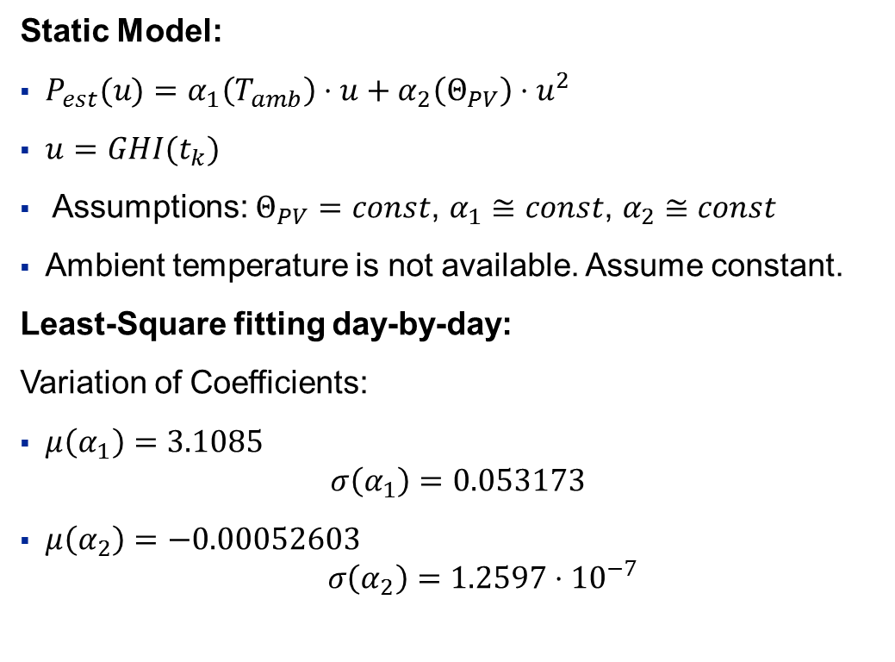
Modeling the PV Power output
Day-by-day fitting
Static Model:
$P_{est}(u)=α_{1}\left(T_{amb}\right)⋅u+α_{2}\left(Θ_{PV}\right)⋅u^{2}$
$u=GHI(t_{k})$
Assumptions: $Θ_{PV}=const$, $α_{1}≅const\text{, }α_{2}≅const$
Ambient temperature is not available. Assume constant.
Least-Square fitting day-by-day:
Variation of Coefficients:
$μ\left(α_{1}\right)=3.1085$ $σ\left(α_{1}\right)=0.053173$
$μ\left(α_{2}\right)=−0.00052603$ $σ\left(α_{2}\right)=1.2597⋅{10}^{−7}$

Slide 7
Modeling the PV Power output
Day-by-day fitting
Clear sky day
Partially cloudy day

Slide 8
Modeling the PV Power output
Day-by-day fitting
Variable day
Very cloudy day

Slide 9
Modeling the PV Power output
Day-by-day fitting
Conclusion:
The simple model performs well, nevertheless the inaccuracy greatly increases for very variable days
Model structure seems to capture the relevant behavior
Parameter adaptation might help given an actual window of GHI and PV output data
Simple idea:
Use a KF to estimate the parameters on the past data window (e.g. 2 hours of past data)
Then assume constant parameters for the future and use the KF to predict the PV output given a GHI prediction vector (e.g. 15min)

Slide 10
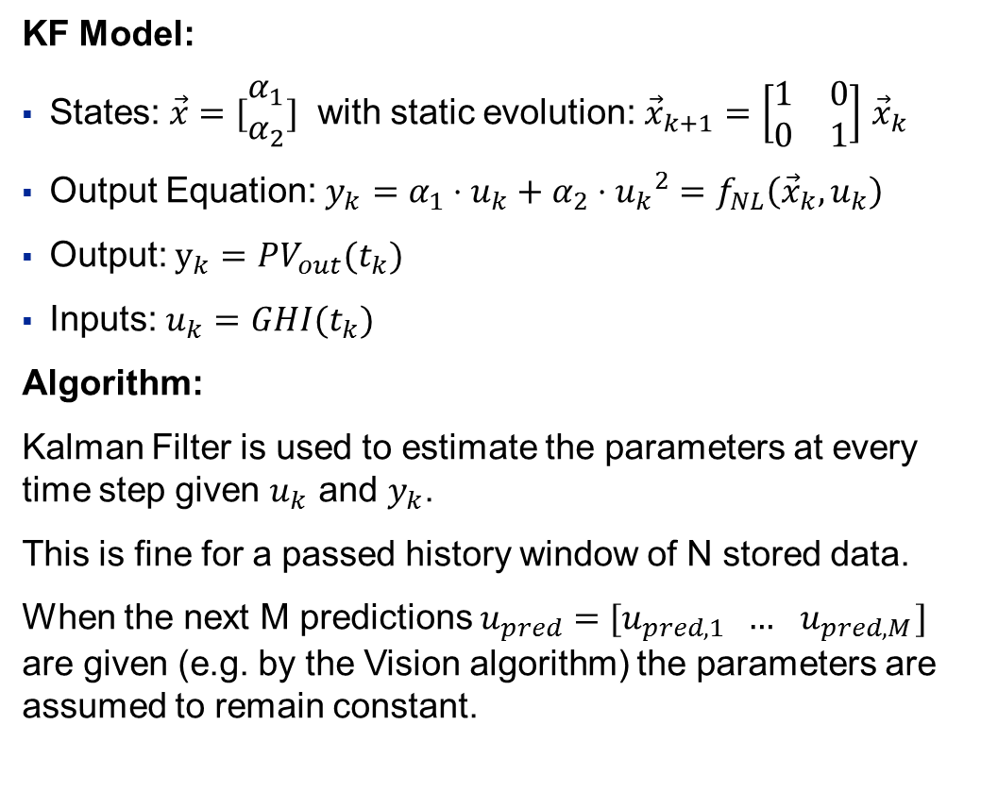
Modeling the PV Power output
Kalman Filter Approach
KF Model:
States: $\vec{x}=[\begin{matrix}α_{1} \\ α_{2}\end{matrix}]$ with static evolution: ${\vec{x}}_{k+1}=\left[\begin{matrix}1 & 0 \\ 0 & 1\end{matrix}\right]$ ${\vec{x}}_{k}$
Output Equation: $y_{k}=α_{1}⋅u_{k}+α_{2}⋅{u_{k}}^{2}=f_{NL}\left({\vec{x}}_{k},u_{k}\right)$
Output: $y_{k}=PV_{out}(t_{k})$
Inputs: $u_{k}=GHI(t_{k})$
Algorithm:
Kalman Filter is used to estimate the parameters at every time step given $u_{k}$ and $y_{k}$.
This is fine for a passed history window of N stored data.
When the next M predictions $u_{pred}=[u_{pred,1} … { u}_{pred,M}]$ are given (e.g. by the Vision algorithm) the parameters are assumed to remain constant.

Slide 11
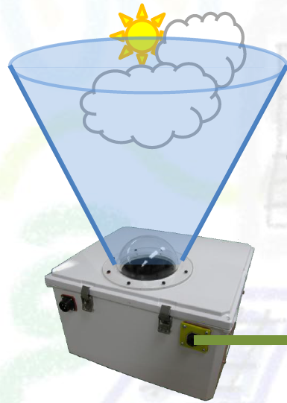






Modeling the PV Power output
Kalman Filter Approach
Algorithm:
$$α_{1}$$
Last N points
$$α_{2}$$
future
$${\vec{y}=P}_{PV}$$
$$\vec{α}$$
KF
$$\vec{u}=GHI$$
$${\vec{P}}_{PV}$$
+
+
Last N points
predicted next M points
Last N points
predicted next M points
VISMO cam
Take action
Vision Algorithm
Clear Sky GHI Model
Cloud detection Classification Motion prediction GHI Prediction
(not considered for now)

Slide 12
Modeling the PV Power output
Kalman Filter Approach
KF PV power prediction for the next 15min
Some Results:
Clear Sky forecast
Kalman Filter

Slide 13
Modeling the PV Power output
Kalman Filter Approach
«Artificial» Vision forecast
KF PV power prediction for the next 15min
Some Results:
Kalman Filter

Slide 14
Modeling the PV Power output
Kalman Filter Approach
Conclusions:
The presented approach works well and is able to predict into the future. Once a GHI 15min forecast is available from the vision system, this is a good starting point for PV power output predictions.

Slide 15
Vision Algorithm
Some Observations (running various image streams)
In the early morning the algorithm is not working. Reason: clouds are very dark, sun very bright. Detection does not work.
Squares do not capture the fineness needed for prediction of an occlusion. Several cloud shapes (especially if there is a high cloud cover) are not represented well enough. The square approximation covers for example 90% of the whole area. (see next slide)
Maybe it is better to track movements of cloud fronts («corners») near the sun, e.g. front coming towards the sun
Problematic is also the fact that sun and clouds are often inside the same object. Once a cloud passed over the sun the object separates into 2 objects. Obviously, a sun detection algorithm is needed.

Slide 16
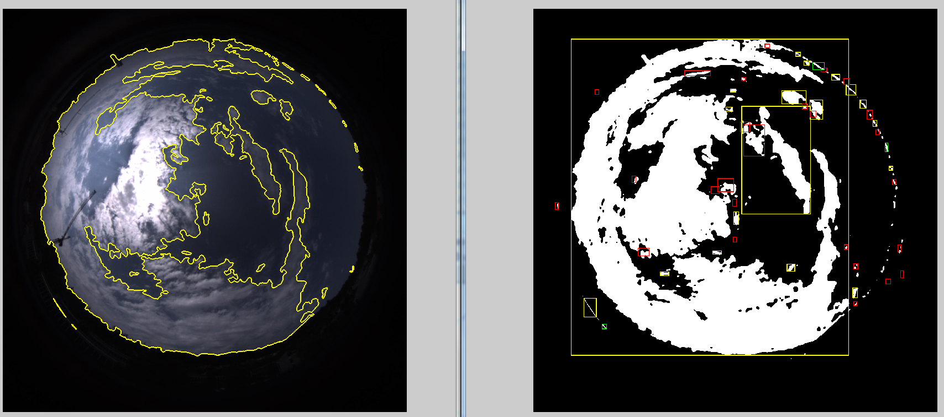

Vision Algorithm
Some Observations (running 2013/07/28)
Image read: 2013_07_28_15_14_36_468.jpeg

Slide 17
General Remarks
The vision algorithm needs to be tested further in order to identify when it works and when it fails. This will be important for Burak in order to fix or improve possible parts of the algorithm.
The bottleneck at the moment is the missing cloud motion prediction and its translation into GHI predictions for specific points on the ground. This will be the hardest part from my point of view.
In general the resolution of the images is not so as high as expected and the images seem quite dark most of the time. I guess a dynamic aperture setting should be introduced.

